Slide 1
NETW211 Course Project Module 5 Cloud Storage John Francis – 7/31/2022

Slide 2
Rubric
Activity | Requirement(s) | Points
Uploading and Accessing a File | Screenshot | 15
Creating Blob Snapshots | Question, Screenshot | 30
Enabling Blob Versioning | Screenshot | 15

Slide 3
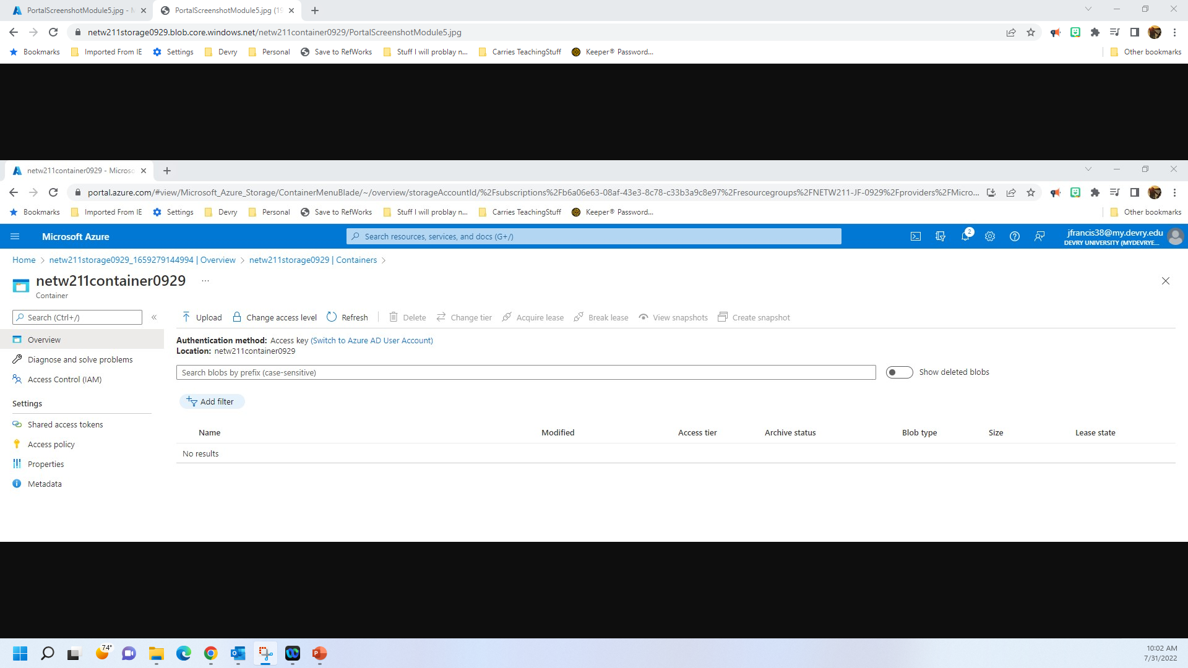
Uploading and Accessing a File
This screenshot should show the browser window with the image uploaded from your local computer and the URL on top of the window.

Slide 4
Question
What does the access tier setting do? What are the Azure blob storage access tiers?
[hint: in the Azure portal, on the Upload blob page, under Advanced, click the ? circle above the Access tier box.]
Answer here:
It allows you to select what type of storage best suits your needs.
Data stored in the cloud grows at an exponential pace. To manage costs for your expanding storage needs, it can be helpful to organize your data based on how frequently it will be accessed and how long it will be retained. Azure storage offers different access tiers so that you can store your blob data in the most cost-effective manner based on how it's being used. Azure Storage access tiers include:
Hot tier - An online tier optimized for storing data that is accessed or modified frequently. The Hot tier has the highest storage costs, but the lowest access costs.
Cool tier - An online tier optimized for storing data that is infrequently accessed or modified. Data in the Cool tier should be stored for a minimum of 30 days. The Cool tier has lower storage costs and higher access costs compared to the Hot tier.
Archive tier - An offline tier optimized for storing data that is rarely accessed, and that has flexible latency requirements, on the order of hours. Data in the Archive tier should be stored for a minimum of 180 days.
Azure storage capacity limits are set at the account level, rather than according to access tier. You can choose to maximize your capacity usage in one tier, or to distribute capacity across two or more tiers.
References (here are two examples to get your research started):
1. Hot, Cool, and Archive access tiers for blob data, https://docs.microsoft.com/en-us/azure/storage/blobs/access-tiers-overview
2. Azure Blob Storage Access Tiers, https://devry.percipio.com/courses/c7ef0333-8560-403f-a004-9c5c843866b0/videos/2658bbe6-ee97-438b-a376-fbb079c3b3a0
3.
4.

Slide 5

Creating Blob Snapshots
This screenshot should show the browser window with the “This is the original version. –Your Initials” message and the URL on top of the window

Slide 6

Enabling Blob Versioning
This screenshot should show the browser window with the “This is the first revised version. –Your Initials” message and the URL on top of the window.

